Slide 1



Forecasting
Data
Case Study Industry

Slide 2




Outline
Introduction to Forecasting
We will discuss about :
Building Forecasting Model using Deep Learning
Hands On!

Slide 3

Introduction
to
Forecasting

Slide 4

Time Series Data
40
30
Time series can be defined as a sequence of a metric is recorded over regular time intervals. Depending on the frequency, a time series can be of yearly, quarterly, monthly etc.
20
10
0
Jan
Feb
Mar
Apr
There are 2 things which Time-series make different from the regular regression problem. First one is Time-dependent. In linear regression models, observations are independent but in this case, observations depend on time. And there can be Seasonality trends, where variations specific to a particular time frame.

Slide 5

There are 2 methods used for time series forecasting.
01
Univariate Time-series Forecasting
Univariate Time-series Forecasting: only two variables in which one is time and the other is the field to forecast.
02
Multivariate Time-series Forecasting
Multivariate Time-series Forecasting: contain multiple variables keeping one variable as time and others will be multiple in parameters.

Slide 6
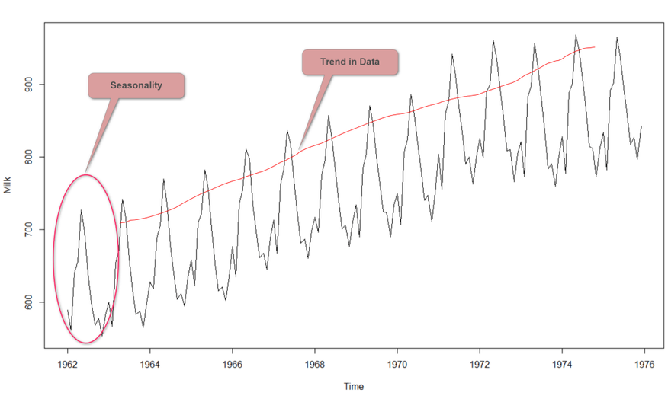
There are some special characteristics needed to be considered when it comes to time series analysis.
01
Trend
The trend is showing the general tendency of the data to increase or decrease with time.
02
Seasonality
Seasonality in a time series is a regular pattern of changes that repeats over S time periods, where S defines the number of periods until the pattern repeats.
For example, if we think about ice cream sales in several years, there will be a high number of sales in summer and low sales in winter. So, this pattern repeats for particular years. So, the S would be 12.

Slide 7
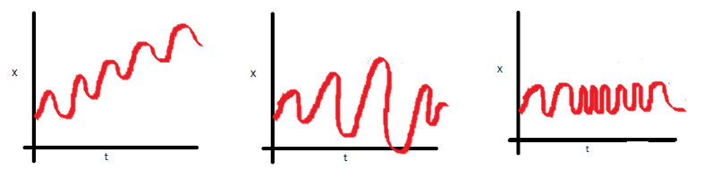
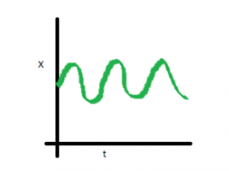
There are some special characteristics needed to be considered when it comes to time series analysis.
03
Stationary
1
2
3
Stationarity means that the statistical properties of a time series which are mean, variance and covariance do not change over time.
In the first plot, mean varies (increases) with time which results in an upward trend.
In the second plot, no trend in the series, but the variance of the series is a vary over time.
In the third plot, the spread becomes closer as the time increases, which means that the covariance is varying over time.
Stationary

Slide 8
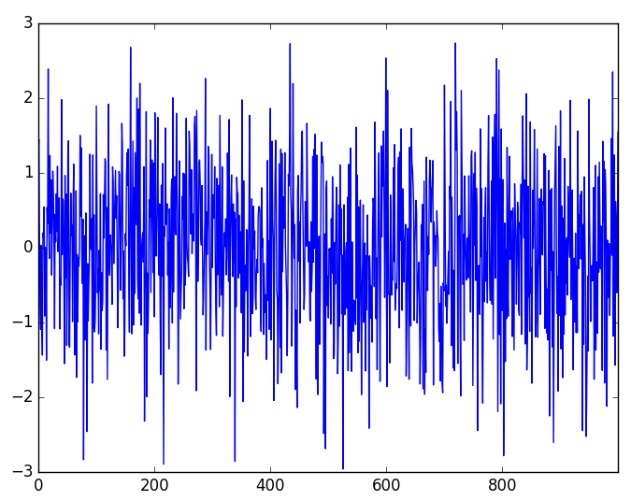
There are some special characteristics needed to be considered when it comes to time series analysis.
04
White Noise
Simply the “white” means all frequencies are equally represented and “noise” is because there’s no pattern, just random variation.
A time series is a white noise if it distributed with a mean of zero, constant variance and a zero correlation between lags. Gaussian white noise, Binary white noise and Sinusoidal white noise are examples for white noise.

Slide 9


What is Time Series Forecasting ?
Time series forecasting is a technique for predicting future events by analyzing past trends, based on the assumption that future trends will hold similar to historical trends. Forecasting involves using models fit on historical data to predict future values. Prediction problems that involve a time component require time series forecasting, which provides a data-driven approach to effective and efficient planning.

Slide 10

Time Series Forecasting Applications
Forecasting power demand to decide whether to build another power generation plant in the next five years
Forecasting call volumes to schedule staff in a call center next week
Forecasting inventory requirements to stock inventory to meet demand
Forecasting supply and demand to optimize fleet management and other aspects of the supply chain
Predicting equipment failures and maintenance requirements to minimize downtime and uphold safety standards
Forecasting infection rates to optimize disease control and outbreak programs
Predicting customer ratings through to forecasting product sales
Predicting price of product
Predict stock value

Slide 11

Building Forecasting Model
using
Deep Learning

Slide 12

Building Forecasting Model using LSTM
Collect data
Preprocessing dataset for time series analysis
Transforming dataset for processing in Tensorflow Keras
Defining target prediction
Creating LSTM model
Evaluate model performance

Slide 13
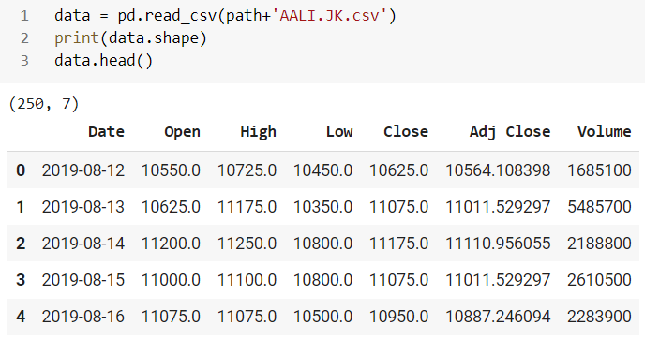

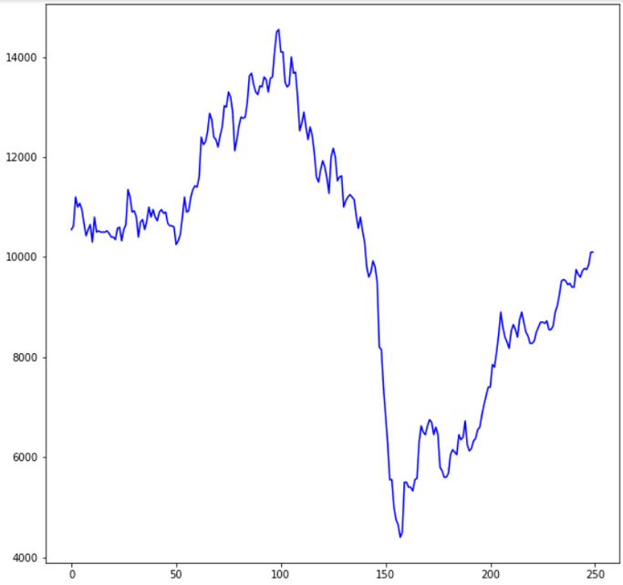
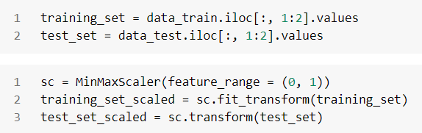

Collecting Data
Plot Data
Split and Scaling Data

Slide 14
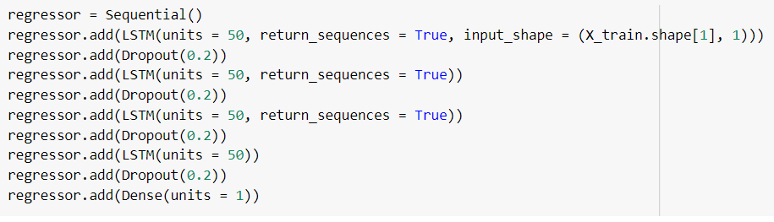
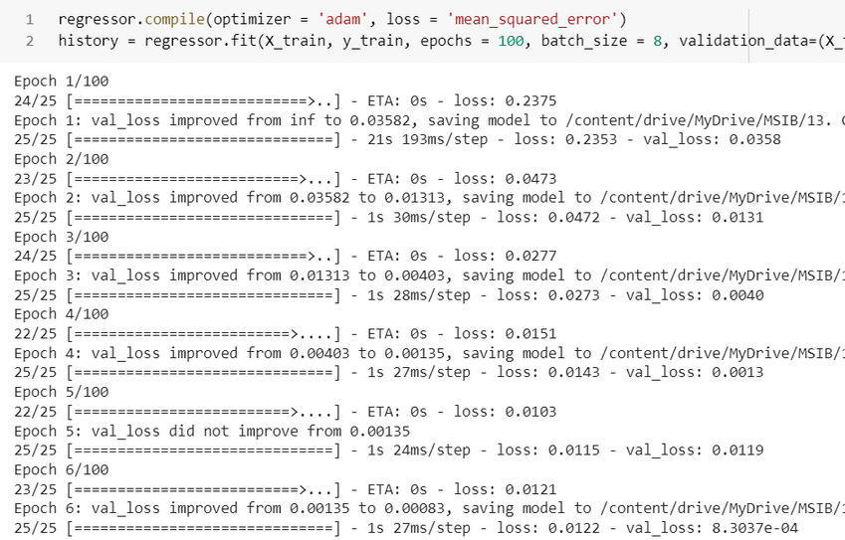


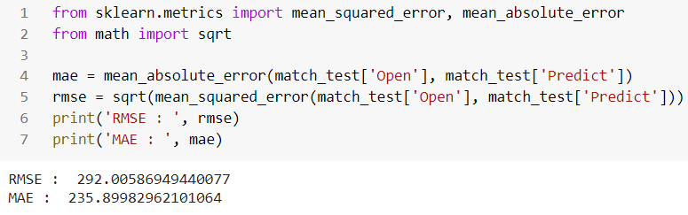

Define Model
Training Process
Set Checkpoint for Save Model
Evaluate Model

Slide 15
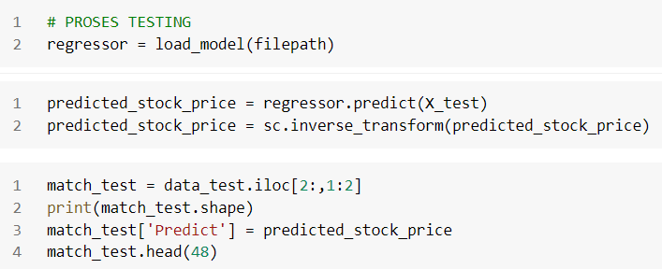
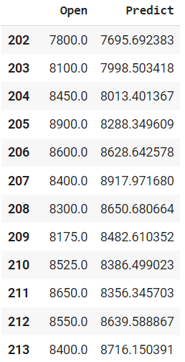


Testing Model
Result

Slide 16



LET'S HANDS ON !!

